Slide 1
SharePoint Framework - Day 2
Jenkins NS
@jenkinsns

Slide 2

Agenda
Loading SharePoint Data in a client web part
Loading SharePoint data
Page Context
Web Services Overview
REST and ODATA Fundamentals
SharePoint REST API’s
Framework HTTP Client

Slide 3
Page Context
The page context provides standard definitions for common SharePoint objects that need to be shared between the client-side application, web parts, and other components. Typically, the data is fetched via REST queries when navigating to a new page, but it can also be preloaded by the web server or filled from a custom application cache.
Provides access to information about current context
Greatly extended version of _spPageContextinfo
Property | Description
aadInfo | If the current page doesn't have an associated Azure Active Directory tenant, this property will be undefined
cultureInfo | It provides culture info for the current user of the application
isInitialized | Returns whether the PageContext has been initialized
list | Contextual information for the SharePoint list that is hosting the page. If there is no list associated to the current page, this property will be undefined
listItem | Contextual information for the SharePoint list item that is hosting the page. If there is no list item associated to the current page, this property will be undefined
site | Contextual information for the SharePoint site collection ("SPSite") that is hosting the page.
user | It provides contextual information for the SharePoint user that is accessing the page. This class is primarily used with the PageContext class.
web | Contextual information for the SharePoint site ("SPWeb") that is hosting the page.

Slide 4
Page Context …
Examples
import { SPPermission } from '@microsoft/sp-page-context’;
this.context.pageContext.web.absoluteUrl
this.context.pageContext.web.permissions.hasAllPermissions(SPPermission.fullMask);
hasAllPermissions : Checks if the user has all the permissions
this.context.pageContext.web.permissions.hasAnyPermissions(SPPermission.manageWeb);
hasAnyPermissions: Checks if the user has any permission from the collection of permissions
this.context.pageContext.web.permissions.hasPermission(SPPermission.viewPages);
has Permission: Checks if the user has given permission

Slide 5
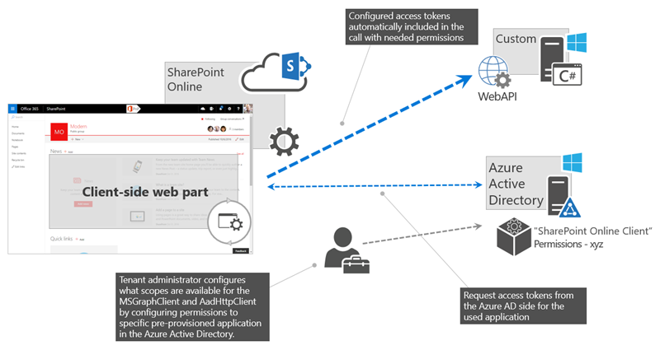
Web Services Overview
Scenario: Customer is having existing web service which is developed into ASP.NET. Currently, we need to develop SPFx web part for SharePoint application. We want to fetch some information using this web service and need to populate into this webpart.
How is authentication handled in the ASP.NET web service?
Answer: By using the AadHttpClient, you can easily connect to APIs secured by using Azure AD without having to implement the OAuth flow yourself
Developers building client-side solutions are responsible for implementing authorization by using the OAuth implicit flow in their application. In SharePoint Framework solutions, that's already done as part of the framework through MSGraphClient and AadHttpClient, both of which are introduced in SharePoint Framework v1.4.1.
Note : If you build solutions on a version of the SharePoint Framework earlier than v1.4.1, you can still connect to resources secured with Azure AD. In this case, you need to implement the OAuth implicit flow by using ADAL JS.
Notes:
https://docs.microsoft.com/en-us/sharepoint/dev/spfx/use-aadhttpclient

Slide 6
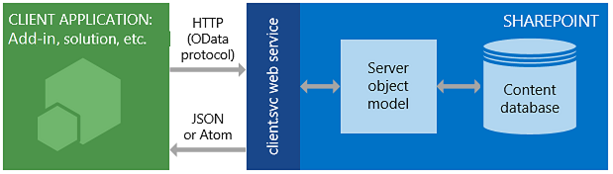
SharePoint REST API’s
SharePoint includes a Representational State Transfer (REST) service that is comparable to the existing SharePoint client object models. Developers can interact remotely with SharePoint data by using any technology that supports REST web requests. This means that developers can perform Create, Read, Update, and Delete (CRUD) operations from their SharePoint Add-ins, solutions, and client applications, using REST web technologies and standard Open Data Protocol (OData) syntax.
To access SharePoint resources using REST, construct a RESTful HTTP request by using the OData standard, which corresponds to the desired client object model API.
https://{site_url}/_api/web
https://{site_url}/_api/site
Example
https://jpower4dev.sharepoint.com/_api/web/lists/GetByTitle('Contactlist')/Items
URL end Points – Some exaples | Description
web/title | Retrieves the title of a list
Lists | Retrieves all lists on a site
lists/getbytitle('listname') | Retrieves a single list's metadata
lists/getbytitle('listname')/items | Retrieves items within a list
lists/getbytitle('listname')?select=Title | Retrieves a specific property of a document

Slide 7
Using HttpClient
HttpClient implements a basic set of features for performing REST operations against a generic service.
import { HttpClient, IHttpClientOptions, HttpClientResponse } from '@microsoft/sp-http’
If you already used the HttpClient and SPHttpClient in your SharePoint Framework projects, you might have noticed that you have two types of request methods options: GET and POST. These two types of requests are the most used ones, but what if you want to use other HTTP methods like PUT, PATCH, DELETE?
If you need to make calls with other HTTP methods, you can make use of the fetch which is available on both the HttpClient and SPHttpClient classes. The fetch method allows you to specify the HTTP method type per request yourself. Fetch is also used behind the scenes when you are using the GET and POST methods.
how you can make use of the fetch method and specifying the request method to perform: spHttpClient
this.props.context.spHttpClient.fetch(restUrl, SPHttpClient.configurations.v1, {
method: "PATCH",
body: JSON.stringify({
"Something": "Some content to patch" })
}).then((response: SPHttpClientResponse) => { // Do your thing});
with the HttpClient, but you will notice that is not that different to use:
this.props.context.httpClient.fetch(restUrl, HttpClient.configurations.v1,
{ method: "DELETE"})
.then((response: HttpClientResponse) => { // Do your thing
});zax

Slide 8
Loading SharePoint data
SharePoint Framework is the new development model and it is a page and Web part model which provides full support for client-side SharePoint development, easy integration with SharePoint data, and support for open-source tooling.
Standard “features” of SPFx
ToolchainAuthenticationSP
GraphAPI and WebAPI Access
CDN hosting
Config experience
Solution hosting
Component is able to get the right application context
Tenant-wide Deployment

Slide 9
Demo
Loading SharePoint lists with a Data Service and Mock Service

Slide 10


Agenda
PnP Controls & SPFx
Overview
Reusable React controls for your SharePoint Framework solutions
Cover all controls and usage
PnP JS Library

Slide 11

SHARING IS CARING
Patterns & Practices
SharePoint Developer Community
Collection of tools and guidance meant to help you extend Microsoft 365 to your needs following best practices.
Don't reinvent the wheel -- focus on what truly matters for your organization.
Learn. Reuse. Share.
https://pnp.github.io/

Slide 12
@pnp/spfx-controls-react
This repository provides developers with a set of reusable React controls that can be used in SharePoint Framework (SPFx) solutions. The project provides controls for building web parts and extensions.
npm install @pnp/spfx-controls-react --save --save-exact
It supports from 1.3.0 spfx
Not support SP2016 and SP2019
https://pnp.github.io/sp-dev-fx-controls-react/

Slide 13
Webpart Controls
https://pnp.github.io/sp-dev-fx-controls-react/
Carousel | Control displays children elements with 'previous/next element' options
Charts | makes it easy to integrate Chart.js charts into web part
ComboBoxListItemPicker | allows to select one or more items from a list
DateTimePicker | DateTime Picker
FilePicker | control that allows to browse and select a file from various places
FileTypeIcon | Control that shows the icon of a specified file path or application
FolderExplorer | Control that allows to browse the folders and sub-folders from a root folder
FolderPicker | Control that allows to browse and select a folder
GridLayout | control that renders a responsive grid layout for your web parts
IconPicker | control that allows to search and select an icon from office-ui-fabric icons
IFrameDialog | renders a Dialog with an iframe as a content
ListItemPicker | allows to select one or more items from a list
ListPicker | allows to select one or multiple available lists/libraries of the current site
ListView | List view control
Map | renders a map in a web part
PeoplePicker | People Picker
Placeholder | shows an initial placeholder if the web part has to be configured
Progress | shows progress of multiple SEQUENTIALLY executed actions
SiteBreadcrumb | Breadcrumb control
SecurityTrimmedControl | intended to be used when you want to show or hide components based on the user permissions
TaxonomyPicker | Taxonomy Picker
TreeView | Tree View
WebPartTitle | Customizable web part title control

Slide 14
Field customizer controls
https://pnp.github.io/sp-dev-fx-controls-react/
FieldAttachmentsRenderer | renders Clip icon based on the provided count property is defined and greater than 0
FieldDateRenderer | renders date string as a simple text
FieldFileTypeRenderer | renders document or folder icon based on file path
FieldLookupRenderer | renders lookup values
FieldNameRenderer | renders document's name as a link
FieldTaxonomyRenderer | renders terms from Managed Metadata field
FieldTextRenderer | renders simple text
FieldTitleRenderer | renders title either as a simple text or as a link to the Display Form
FieldUrlRenderer | renders Hyperlink or Picture field value as a link or image
FieldUserRenderer | renders each referenced user/group as a link on a separate line

Slide 15
PnP Library Overview
PnPjs is a collection of fluent libraries for consuming SharePoint, Graph, and Office 365 REST APIs in a type-safe way. You can use it within SharePoint Framework, Nodejs, or any JavaScript project. This an open source initiative and we encourage contributions and constructive feedback from the community.
Packages
Patterns and Practices client-side libraries (PnPjs) are comprised of the packages listed below. All of the packages are published as a set and depend on their peers within the @pnp scope.
adaljsclient | Provides an adaljs wrapper suitable for use with PnPjs
common | Provides shared functionality across all pnp libraries
config-store | Provides a way to manage configuration within your application
graph | Provides a fluent api for working with Microsoft Graph
logging | Light-weight, subscribable logging framework
msaljsclient | Provides an msal wrapper suitable for use with PnPjs
nodejs | Provides functionality enabling the @pnp libraries within nodejs
odata | Provides shared odata functionality and base classes
sp | Provides a fluent api for working with SharePoint REST
sp-addinhelpers | Provides functionality for working within SharePoint add-ins
https://pnp.github.io/pnpjs/

Slide 16
@pnp/sp
This package contains the fluent api used to call the SharePoint rest services.
Install the library and required dependencies
npm install @pnp/sp –save
npm install @pnp/sp @pnp/graph –save (for graph implementation)
Import the library into your application and access the root sp object
import { sp } from "@pnp/sp";
import "@pnp/sp/webs";
(function main() {
// here we will load the current web's title sp.web.select("Title")().then(w => {
console.log(`Web Title: ${w.Title}`);
});
})()
https://pnp.github.io/pnpjs/

Slide 17
@pnp/sp
npm install @pnp/sp --save
import { sp } from "@pnp/sp";
Add
sp.web.lists.getByTitle('Listname').items.add({ columnname=coloumnvalue });
Update
sp.web.lists.getByTitle('Listname').items.getById(ID).update({ columnname=coloumnvalue});
Delete
sp.web.lists.getByTitle('Listname').items.getById(ID).delete();
Get List Items
pnp.sp.web.lists.getByTitle("ProfileList").items.get().then((response) => {
return response;
});
https://pnp.github.io/pnpjs/

Slide 18
Demo
Create a SPFx webpart with PnP controls

Slide 19


Slide 20
Fluent UI
Overview
Fluent UI for the web is available in two flavors: Fluent UI React and Fabric Core.
Fluent UI React
Fluent UI React is the official open-source React front-end framework designed to build experiences that fit seamlessly into a broad range of Microsoft products. It provides robust, up-to-date, accessible components which are highly customizable using CSS-in-JS. Get started with Fluent UI React
Fabric Core
Fabric Core is an open-source collection of CSS classes and Sass that give you access to colors, animations, fonts, icons and grid. Get started with Fabric Core

Slide 21
Fluent UI React
Getting started developing with Fluent UI React is simple!
Add to existing project
Fluent UI React is available via the @fluentui/react npm package. To use this package in an existing project
npm install @fluentui/react
To Use the control
import { PrimaryButton } from '@fluentui/react';

Slide 22
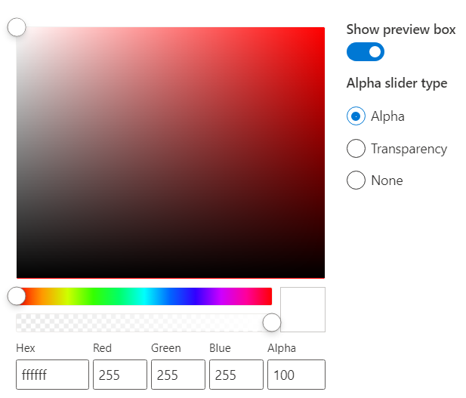
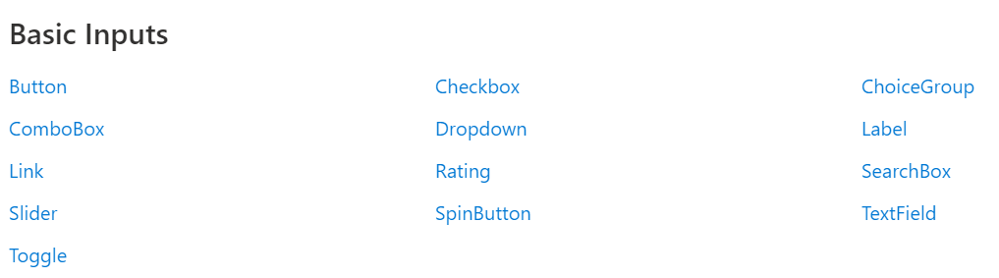
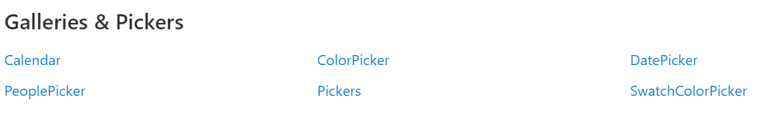
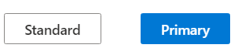
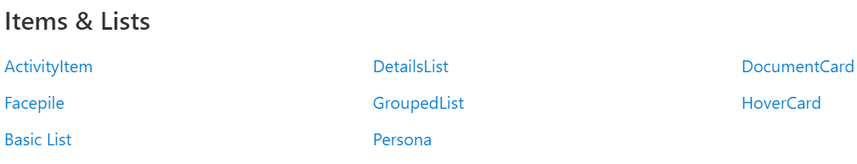
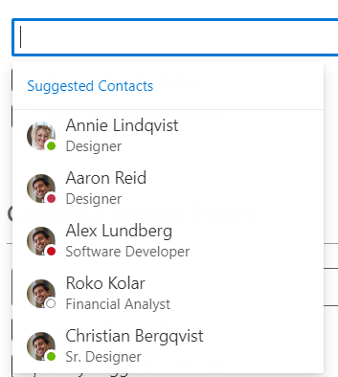
Fluent UI Controls
https://developer.microsoft.com/en-us/fluentui#/controls/web

Slide 23
Agenda
React JS Essentials
What is React JS
What is JSX
React Components
Html Tags vs React Components
Creating Components
JavaScript Expressions
Relationship with State Machines
Handling Component State
Adding Interactivity by means of events
Using Multiple Components
Transferring props between components
The Lifecycle of a Component
Alternative Syntax
SharePoint Framework and React

Slide 24


What is a React JS?
React is a JavaScript library created by Facebook
React is a User Interface (UI) library
React is a tool for building UI components
Building Single Page Application (SPA)
Allows reusability
Basically react is the view layer of an MVC application.
React makes it painless to create interactive UIs. Design simple views for each state in your application and React will efficiently update and render just the right components when your data changes.

Slide 25
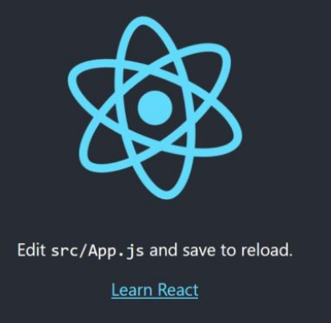
Create react app
Create React App is a comfortable environment for learning React and is the best way to start building a new single-page application in React.
npm the package manager
npm (node package manager) is the dependency/package manager you get out of the box when you install Node.js. It provides a way for developers to install packages both globally and locally.
npx the package runner
npx is also a CLI tool whose purpose is to make it easy to install and manage dependencies hosted in the npm registry.
It’s now very easy to run any sort of Node.js based executable that you would normally install via npm.
npx helps us avoid versioning, dependency issues and installing unnecessary packages that we just want to try out.
npx create-react-app my-app
cd my-app
npm start

Slide 26
What is a JSX?
JSX:
const myelement = <h1>I Love JSX!</h1>;
ReactDOM.render(myelement, document.getElementById('root’));
Without JSX
const myelement = React.createElement('h1', {}, 'I do not use JSX!');
ReactDOM.render(myelement, document.getElementById('root’));
Expressions in JSX
const myelement = <h1>React is {5 + 5} times better with JSX</h1>;
Large list
const myelement = (
<ul>
<li>Apples</li>
<li>Bananas</li>
<li>Cherries</li>
</ul>
);
Closed all tags
const myelement = <input type="text" />;
JSX is an embeddable XML-like syntax. It is meant to be transformed into valid JavaScript, though the semantics of that transformation are implementation-specific. JSX rose to popularity with the React framework but has since seen other implementations as well. TypeScript supports embedding, type checking, and compiling JSX directly to JavaScript.
Expressions in JSX
With JSX you can write expressions inside curly braces { }.

Slide 27
React Components and Props
React Components
Props
React is made up of Components
E-Books
Shopping Cart
My Orders
Purchase
Electronics
Stock

Slide 28
React Components
Create a Class Component
class Car extends React.Component { render() { return <h2>Hi, I am a Car!</h2>; } }
Components are independent and reusable bits of code. They serve the same purpose as JavaScript functions, but work in isolation and returns HTML via a render function.
Components come in two types, Class components and Function components, in this tutorial we will concentrate on Class components.
ReactDOM.render(<Car />, document.getElementById('root'));
Create a Function Component
function Car() { return <h2>Hi, I am also a Car!</h2>; }
ReactDOM.render(<Car />, document.getElementById('root'));
Component Constructor
class Car extends React.Component {
constructor() {
super();
this.state = {color: "red"}; }
render()
{ return <h2>I am a Car!</h2>; }
}
class Car extends React.Component { constructor() {
super();
this.state = {color: "red"}; }
render()
{ return <h2>I am a {this.state.color} Car!</h2>; }
}

Slide 29
React Props
Props are arguments passed into React components.
Props are passed to components via HTML attributes.
class Car extends React.Component {
render()
{
return <h2>I am a {this.props.brand}!</h2>;
}
}
class Garage extends React.Component
{
render()
{ return (
<div>
<h1>Who lives in my garage?</h1>
<Car brand="Ford" />
</div> );
} }
ReactDOM.render(<Garage />, document.getElementById('root'));

Slide 30
React State
Built in Objects
Exclusive for each component
Allows react components to change the output over time
Triggers the Components to re-enter
When the state object changes, the component re-renders.

Slide 31
Where to initialize or creating the state
The state object is initialized in the constructor
Component
constructor(props) {
super(props);
this.state = {
brand: "Ford",
model: "Mustang",
color: "red",
year: 1964
};
Constructor
Functions
Render()
{
return <div><div>; }

Slide 32
Rendering to the state object
Refer to the state object anywhere in the component by using the this.state.propertyname syntax
Component
render() {
return (
<div>
<h1>My {this.state.brand}</h1>
<p>
It is a {this.state.color}
{this.state.model}
from {this.state.year}.
</p>
</div>
);
}
Constructor
Functions
Render()
{
return <div><div>; }

Slide 33
Changing the state
To change a value in the state object, use the this.setState() method.
When a value in the state object changes, the component will re-render, meaning that the output will change according to the new value(s)
changeColor = () => {
this.setState({color: "blue"});
}
render() {
return (
<div>
<h1>My {this.state.brand}</h1>
<p>
It is a {this.state.color}
{this.state.model}
from {this.state.year}.
</p>
<button
type="button"
onClick={this.changeColor}
>Change color</button>
</div>
);
}
Component
Constructor
Functions
Render()
{
return <div><div>; }

Slide 34

React Virtual DOM
What is DOM? (actual DOM)
Document object model, it represent HTML element logical tree Structure
What is Virtual DOM?
React uses virtual DOM to enhance its performance. It uses the observable to detect state and prop changes. React uses an efficient diff algorithm to compare the versions of virtual DOM. It then makes sure that batched updates are sent to the real DOM for repainting or re-rendering of the UI.
Like the actual DOM, the Virtual DOM is a node tree that lists elements and their attributes and content as objects and properties. React's render() method creates a node tree from React components and updates this tree in response to mutations in the data model, caused by actions.

Slide 35
DOM
Virtual DOM

Slide 36
DOM
Virtual DOM

Slide 37
DOM
Virtual DOM
Diffing

Slide 38
React Components are dynamic
Properties
Public settings on components
Similar to HTML element attributes
Use to provide values into components
Use to publish events to consumers
Defined on the component via Typescript interfaces
State
State object of a component is a special property bag
React detects when the state changes & triggers a (re)render of the component
Change the state using the components setState() method
Defined on the components via Typescript interfaces

Slide 39
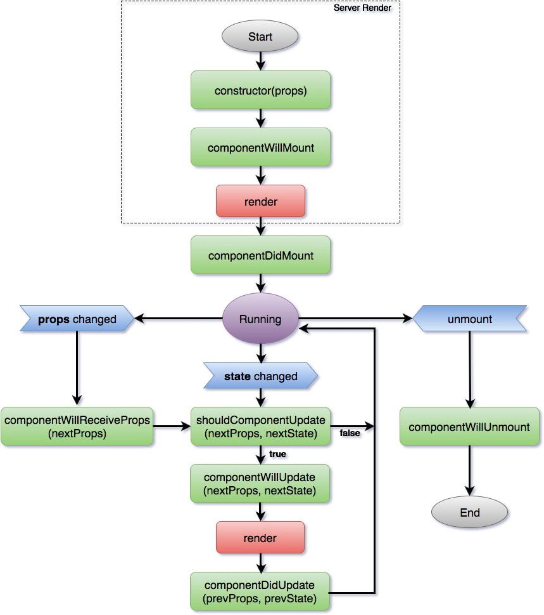
React Components life Cycle
Each component has several “lifecycle methods” that you can override to run code at particular times in the process. You can use this lifecycle methods.
Mounting
These methods are called in the following order when an instance of a component is being created and inserted into the DOM:
constructor()
render()
componentDidMount()
Updating
An update can be caused by changes to props or state. These methods are called in the following order when a component is being re-rendered:
getSnapshotBeforeUpdate()
componentDidUpdate()
Unmounting
This method is called when a component is being removed from the DOM:
componentWillUnmount()

Slide 40
Demo
Create SPFx webpart using React
Create SPFx webpart using React and load data from SharePoint
Curd Operations React

Slide 41
References
Overview of the SharePoint Framework
https://docs.microsoft.com/sharepoint/dev/spfx/sharepoint-framework-overview
Overview of SharePoint Framework Extensions
https://docs.microsoft.com/sharepoint/dev/spfx/extensions/overview-extensions
Use Page Placeholders from Application Customizer
https://docs.microsoft.com/sharepoint/dev/spfx/extensions/get-started/using-page-placeholder-with-extensions
Tenant Wide Deployment of SharePoint Framework Extensions
https://docs.microsoft.com/sharepoint/dev/spfx/extensions/basics/tenant-wide-deployment-extensions
Build your First Field Customizer Extension
https://docs.microsoft.com/sharepoint/dev/spfx/extensions/get-started/building-simple-field-customizer
Build your First ListView Command Set extension
https://docs.microsoft.com/en-us/sharepoint/dev/spfx/extensions/get-started/building-simple-cmdset-with-dialog-api

Slide 42



SPFx Info
https://docs.microsoft.com/en-us/sharepoint/dev/spfx/sharepoint-framework-overview
Twitter
@ m365pnp
Tech Community
aka.ms/sppnp-community

